Slide 1


Slide 2



BATCH PROCESSING,
ROW SET

Slide 3

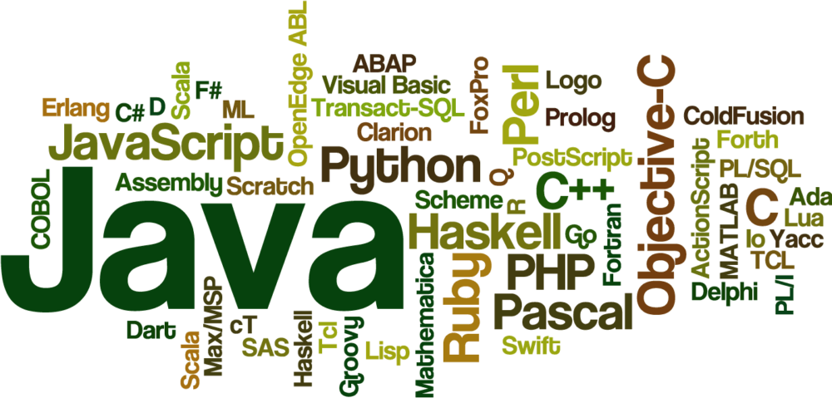


Slide 4
JDBC BATCH PROCESSING
The JDBC batch processing provides the facility to execute a group of related queries.
A group of related queries is known as a batch.
It reduces the amount of communication overhead and hence improves the performance

Slide 5
JDBC batch processing methods
1.addBatch(String query): It is used to add the statement to the batch.
public void void addBatch(String query) throws SQLException
2. executeBatch(): It is used to execute batch.
public int[] executeBatch() throws SQLException
3. clearBatch(): It is used to remove all statements from the batch.
public void clearBatch() throws SQLException

Slide 6
BATCH UPDATE USING JDBC
The JDBC statement is used to execute queries against the database.
import java.sql.Connection; import java.sql.Statement; import com.codesjava.util.JDBCUtil; public class JDBCTest { public static void main(String args[]){ Connection conn = null; Statement statement = null; String query1 = "insert into EMPLOYEE " + "(EMPLOYEE_ID, NAME, SALARY) " + "values (1, 'Harish Yadav', 50000)"; String query2 = "insert into EMPLOYEE " + "(EMPLOYEE_ID, NAME, SALARY) " + "values (5, 'Abhishek Rathor', 50000)";

Slide 7
CONTINUED…
try{ //get connection conn = JDBCUtil.getConnection(); //create statement statement = conn.createStatement(); //set auto commit to false conn.setAutoCommit(false); //add queries to batch statement.addBatch(query1); statement.addBatch(query2);

Slide 8
CONTINUED..
//execute batch statement.executeBatch(); //commit conn.commit(); //close connection statement.close(); conn.close(); System.out.println("Records inserted successfully."); }catch(Exception e){ e.printStackTrace(); } } }
Notes:
Successfully connected.
Record inserted successfully

Slide 9
BATCH UPDATE USING PREPARED STATEMENTS:
import java.sql.Connection; import java.sql.PreparedStatement; import com.codesjava.util.JDBCUtil; public class JDBCTest { public static void main(String args[]){ Connection conn = null; PreparedStatement preparedStatement = null; String query = "insert into EMPLOYEE " + "(EMPLOYEE_ID, NAME, SALARY) " + "values (?,?,?)"; try{ //get connection conn = JDBCUtil.getConnection(); //set auto commit to false conn.setAutoCommit(false);

Slide 10
CONTINUED…
//create preparedStatement preparedStatement = conn.prepareStatement(query); //set values preparedStatement.setInt(1, 1); preparedStatement.setString(2, "Bharat"); preparedStatement.setInt(3, 62000); preparedStatement.addBatch(); //set values preparedStatement.setInt(1, 4); preparedStatement.setString(2, "Bharti"); preparedStatement.setInt(3, 52000); preparedStatement.addBatch(); //execute query preparedStatement.executeBatch();

Slide 11
CONTINUED..
//commit conn.commit(); //close connection preparedStatement.close(); conn.close(); System.out.println("Record inserted successfully."); }catch(Exception e){ e.printStackTrace(); } } }

Slide 12
ROW SET INTERFACE
A RowSet is an object that encapsulates a set of rows from either java Database Connectivity (JDBC) result sets or tabular data sources.
RowSets support component-based development models like JavaBeans, with a standard set of properties and an event notification mechanism

Slide 13
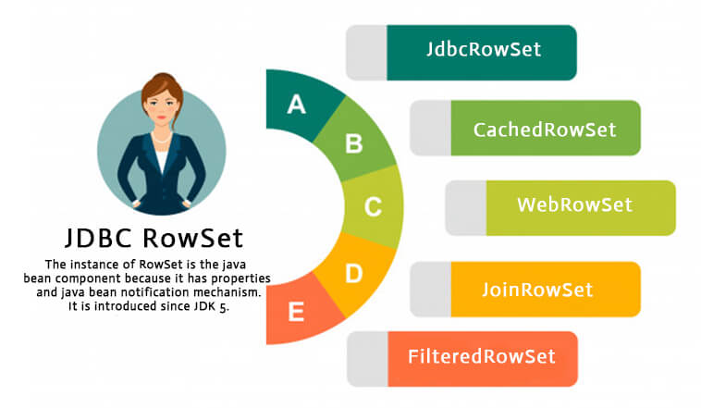
IMPLEMENTATION OF ROWSET:

Slide 14
EXAMPLE :
import java.sql.Connection; import java.sql.DriverManager; import java.sql.ResultSet; import java.sql.Statement; import javax.sql.RowSetEvent; import javax.sql.RowSetListener; import javax.sql.rowset.JdbcRowSet; import javax.sql.rowset.RowSetProvider; classRowSetDemo { public static void main(String args[]) { try { Class.forName("oracle.jdbc.driver.OracleDriver"); JdbcRowSet rowSet = RowSetProvider.newFactory().createJdbcRowSet();

Slide 15
CONTINUED…
rowSet.setUrl("jdbc:oracle:thin:@localhost:1521:xe"); rowSet.setUsername("scott"); rowSet.setPassword("tiger"); rowSet.setCommand("select * from Student"); rowSet.execute(); while(rowSet.next()) { System.out.println("RollNo: "+ rowSet.getInt(1)); System.out.println("Name: "+ rowSet.getString(2)); System.out.println("Course: "+ rowSet.getString(3)); } } catch(Exception e) { e.printStackTrace(); } } }

Slide 16

THANK YOU

